Slide 1
SpaceX Final Assignment
Bayu Fathurrahman

Slide 2
Executive Summary
Methodologies
Data Collection with API
Data Wrangling
EDA with SQL
EDA and Data Viz with pandas
Mapping with Folium
Machine Learning Prediction
Results
EDA results
Classification modelling results

Slide 3
Table of Contents
Introduction
Methodology
Results
Discussion
Conclusion
Appendix

Slide 4
Introduction
In this capstone, we will predict if the Falcon 9 first stage will land successfully. SpaceX advertises Falcon 9 rocket launches on its website with a cost of 62 million dollars; other providers cost upward of 165 million dollars each, much of the savings is because SpaceX can reuse the first stage. Therefore if we can determine if the first stage will land, we can determine the cost of a launch. This information can be used if an alternate company wants to bid against SpaceX for a rocket launch.
Problems:
Do we have an increasing rate of success over time?
How does payload affects the success rate of the landing?
Which features contribute to the success rate of the landing?

Slide 5
Methodology

Slide 6
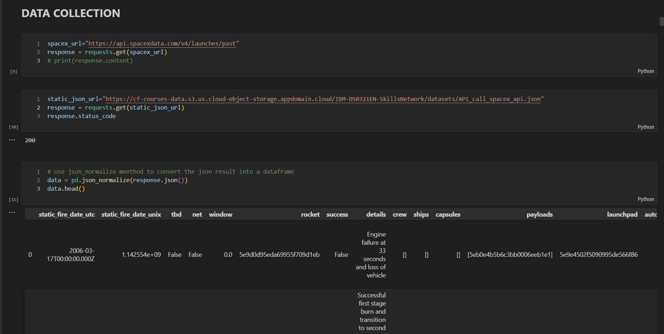
Data collection with API

Slide 7
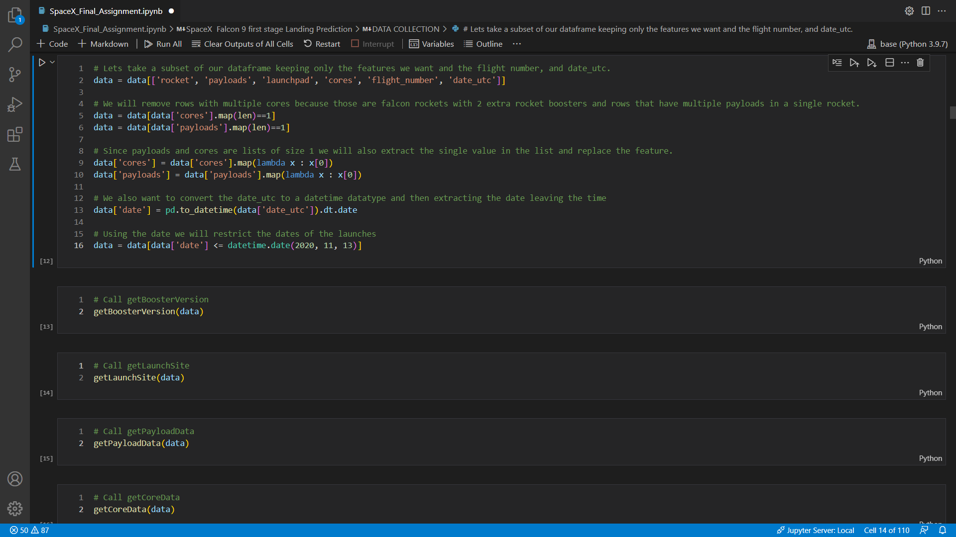
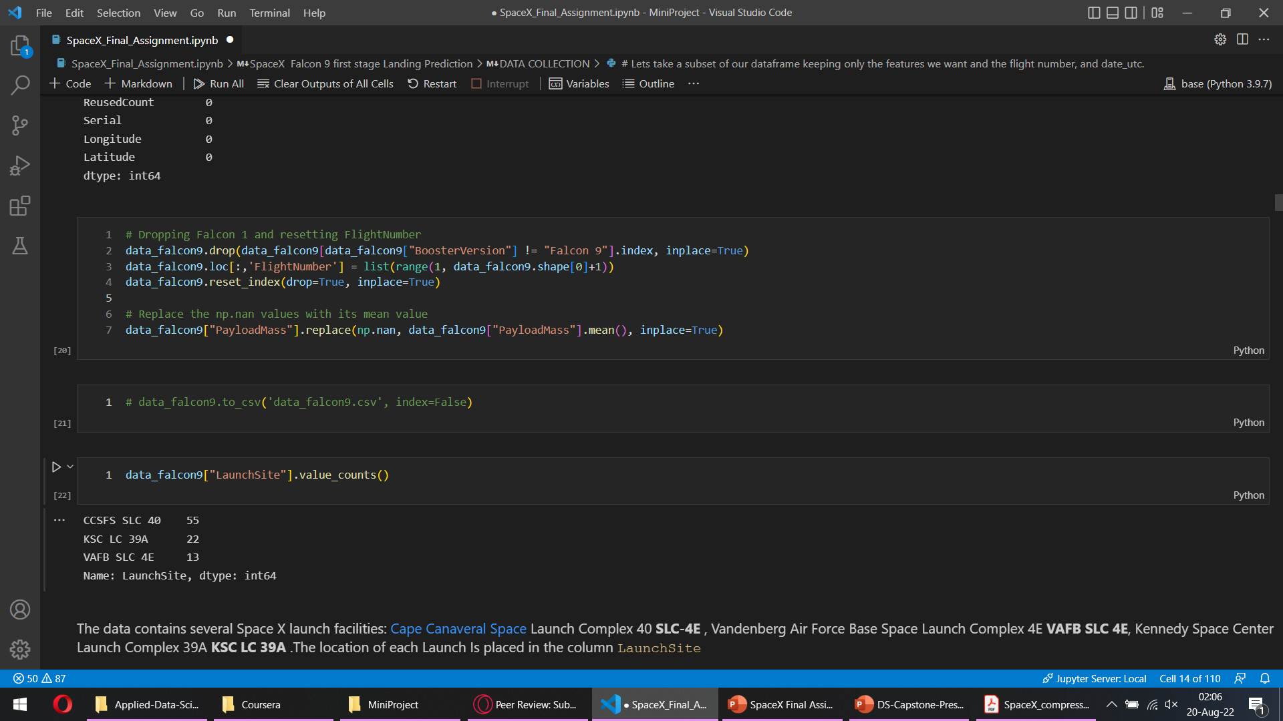
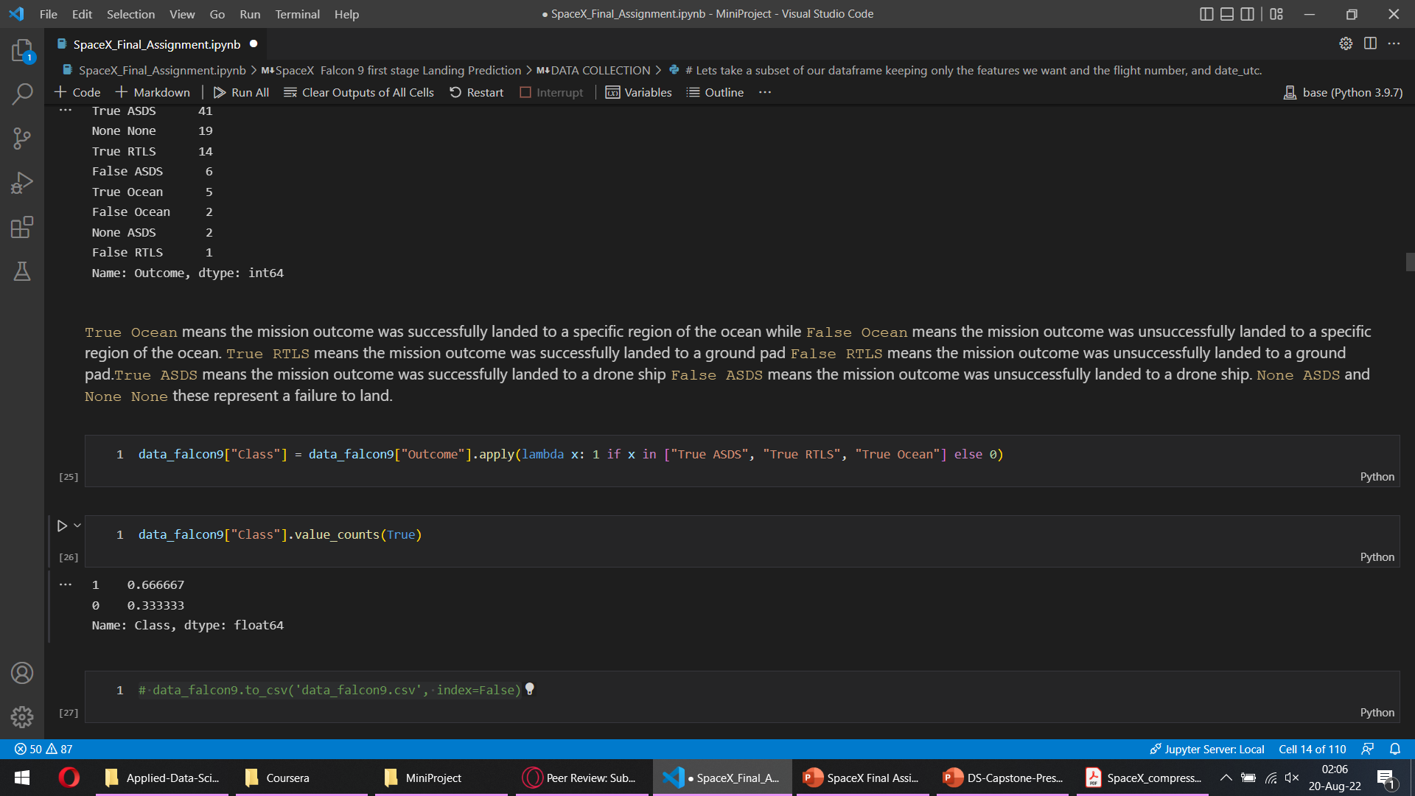
Data Wrangling

Slide 8
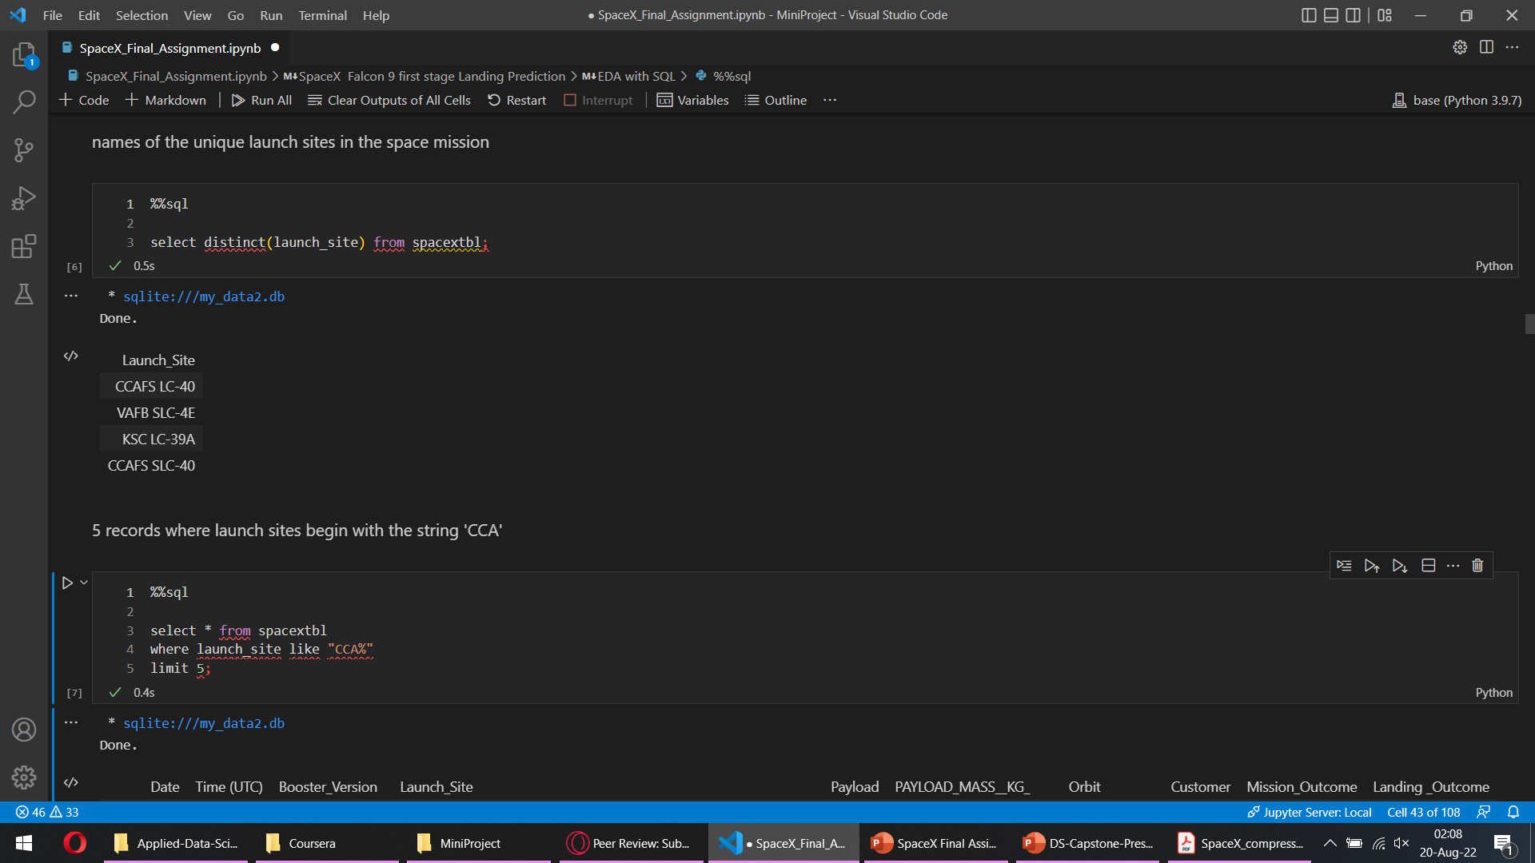
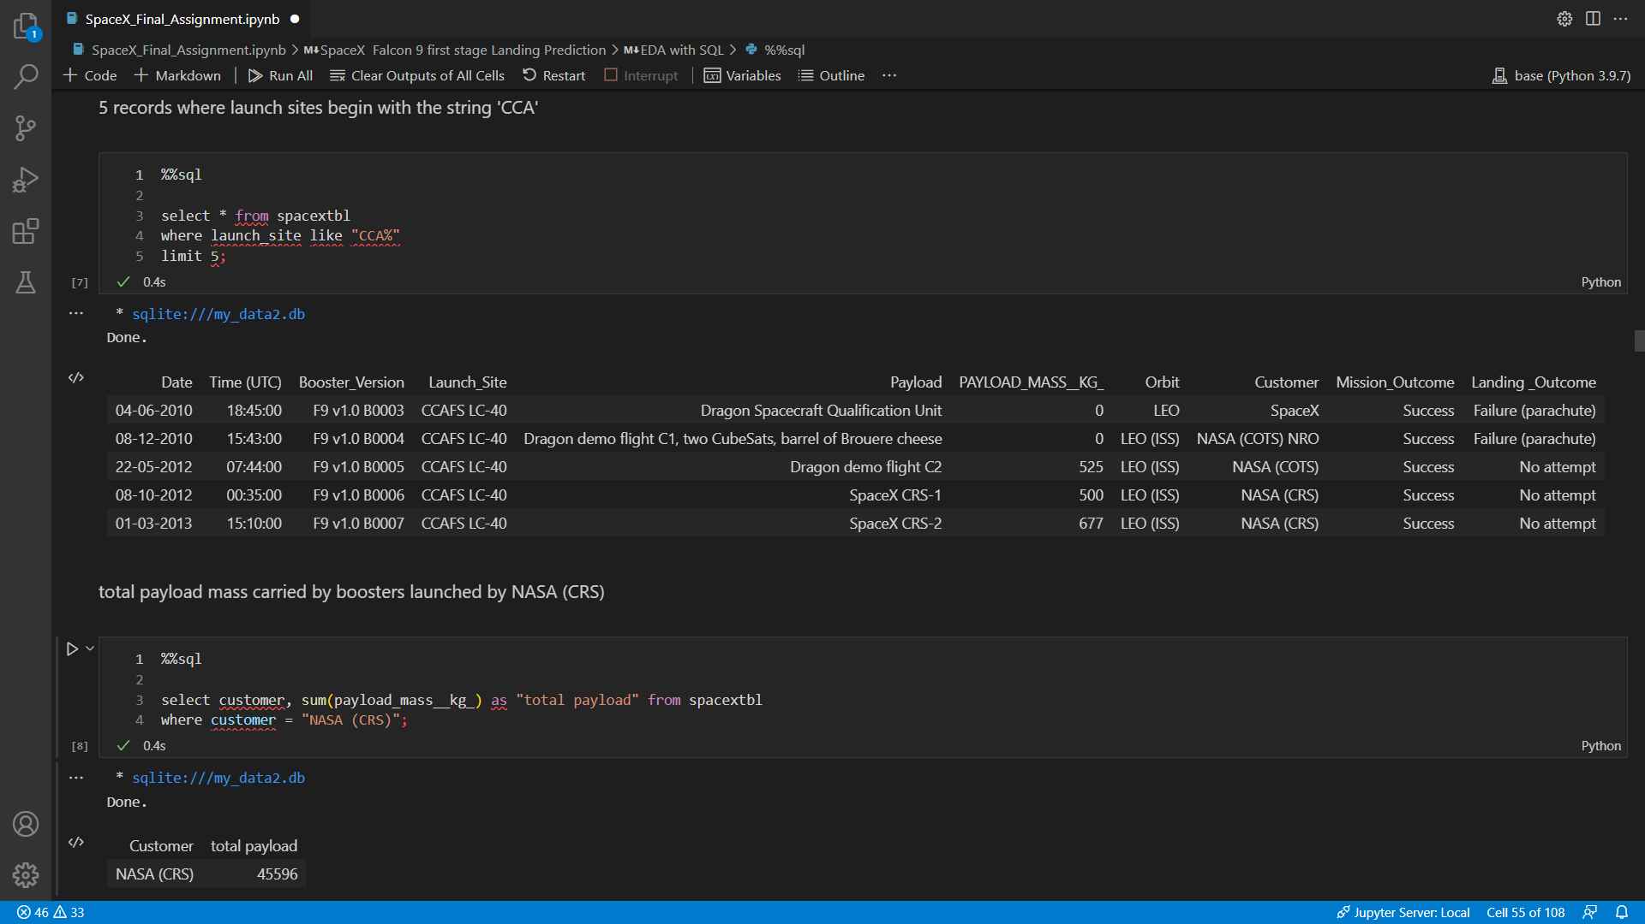
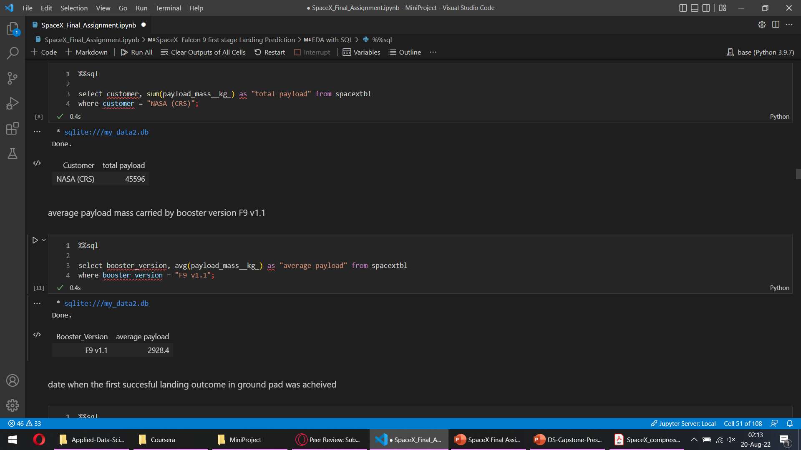
EDA with SQL

Slide 9
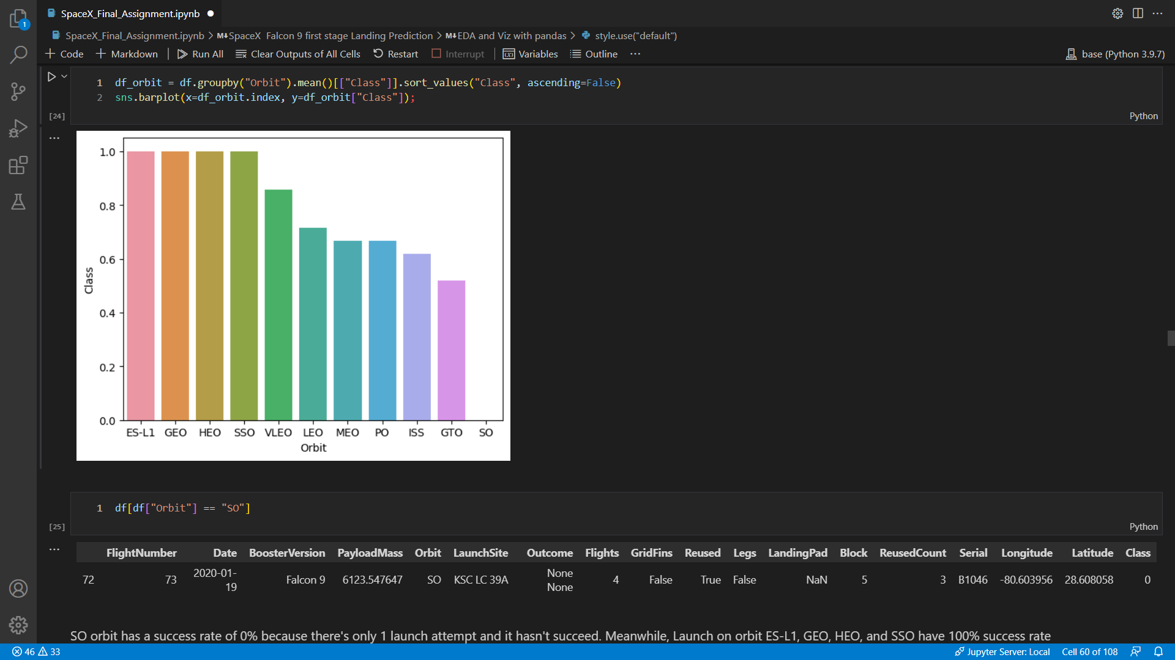
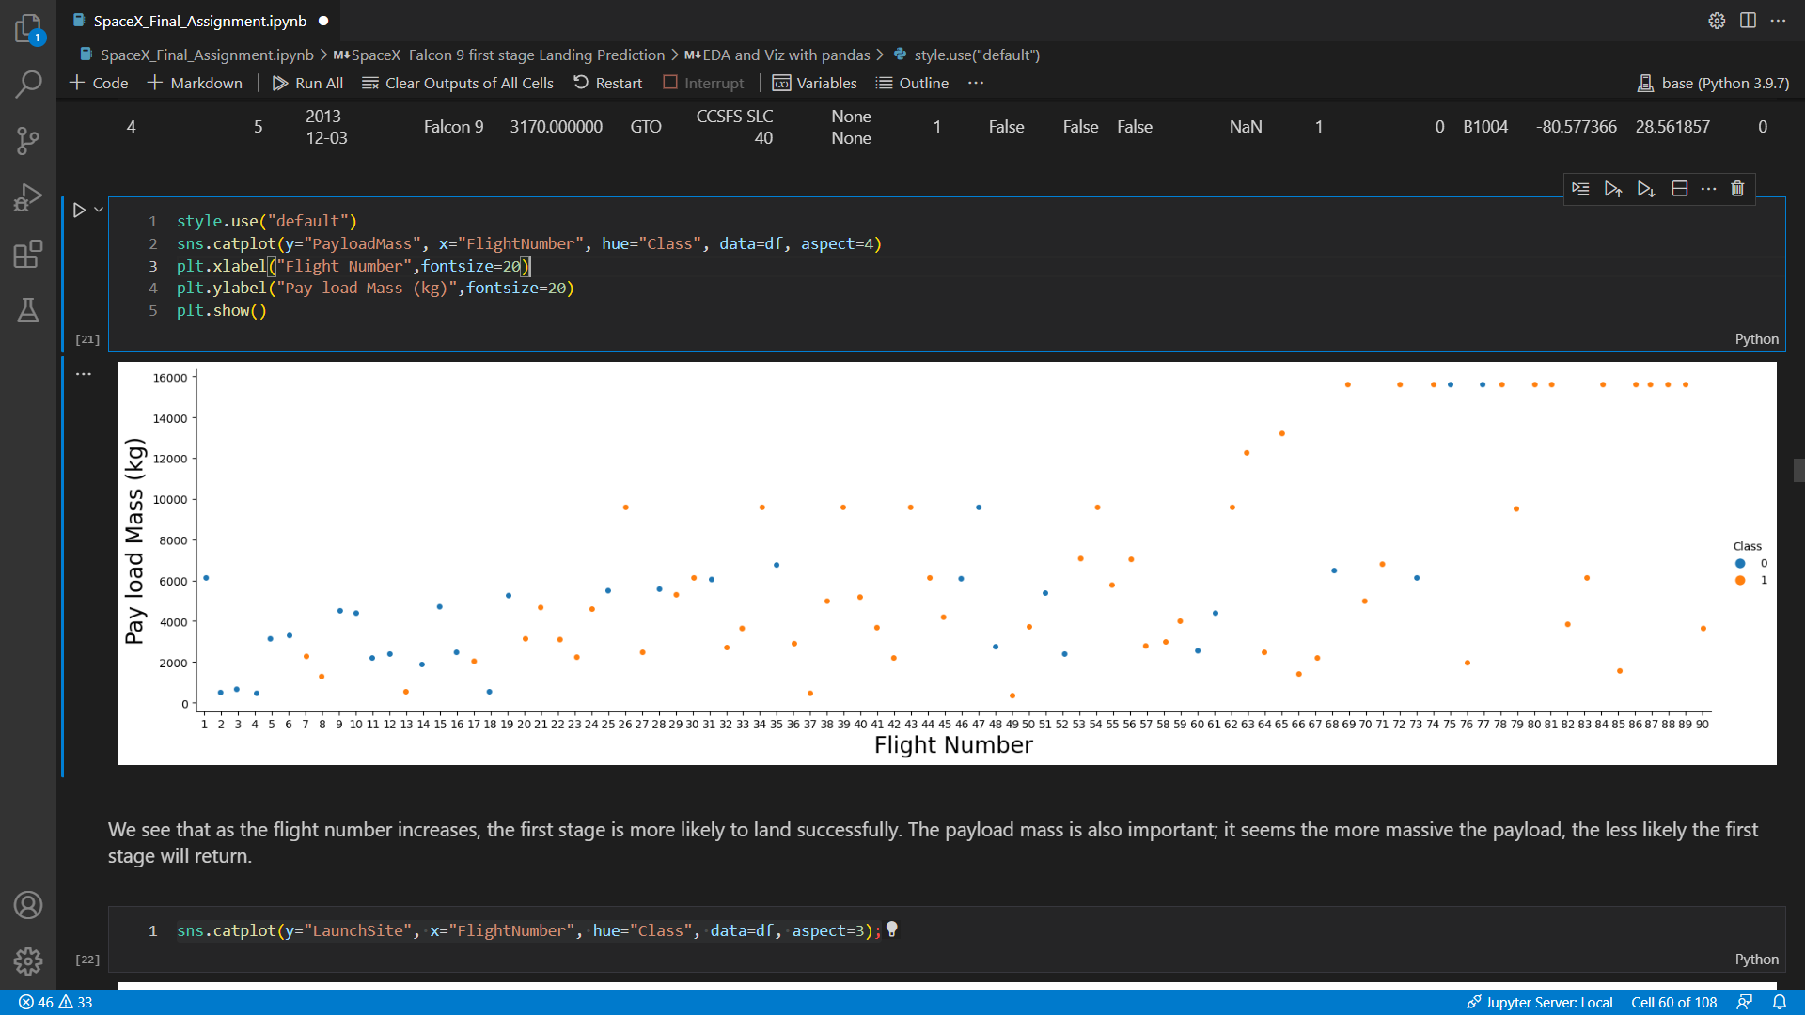
EDA with pandas

Slide 10
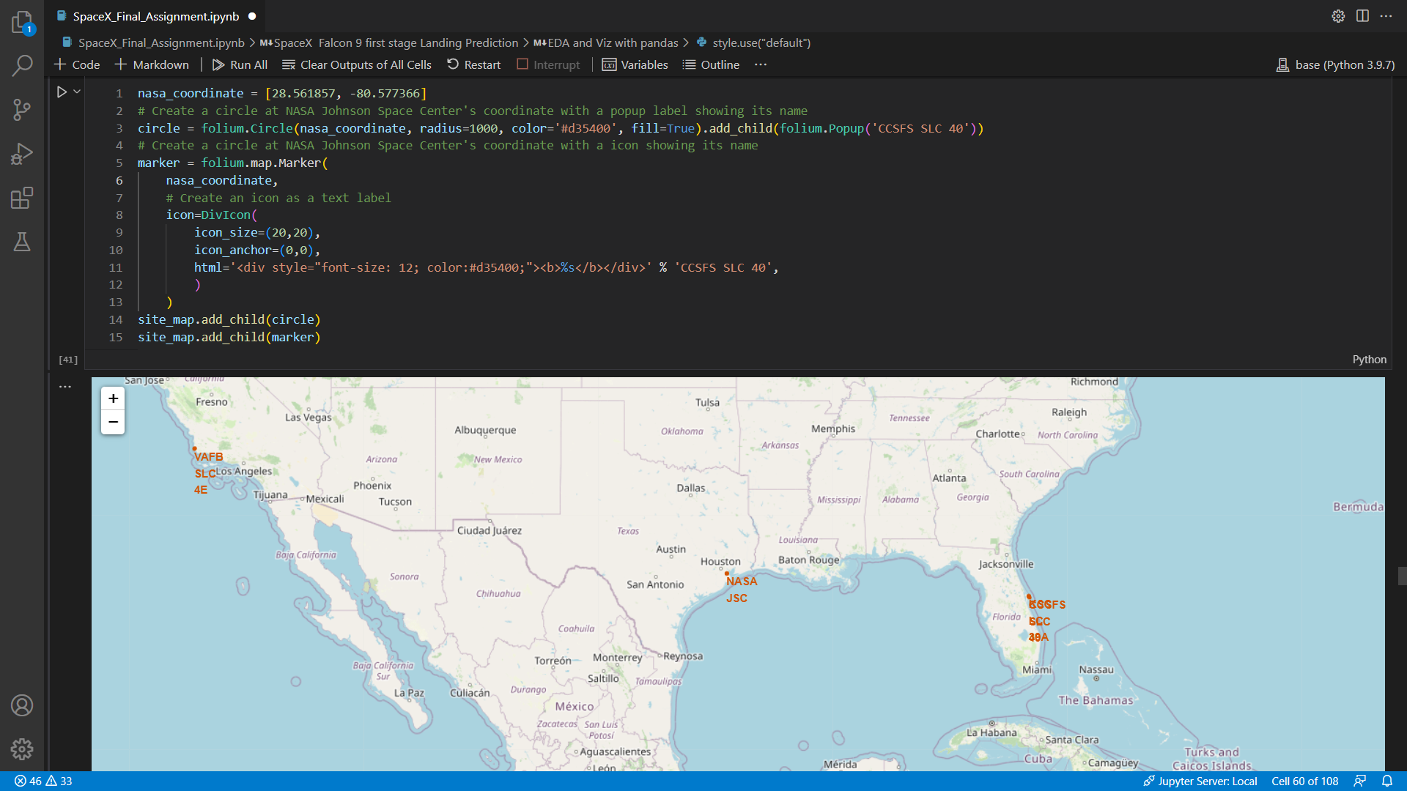
Mapping with Folium

Slide 11
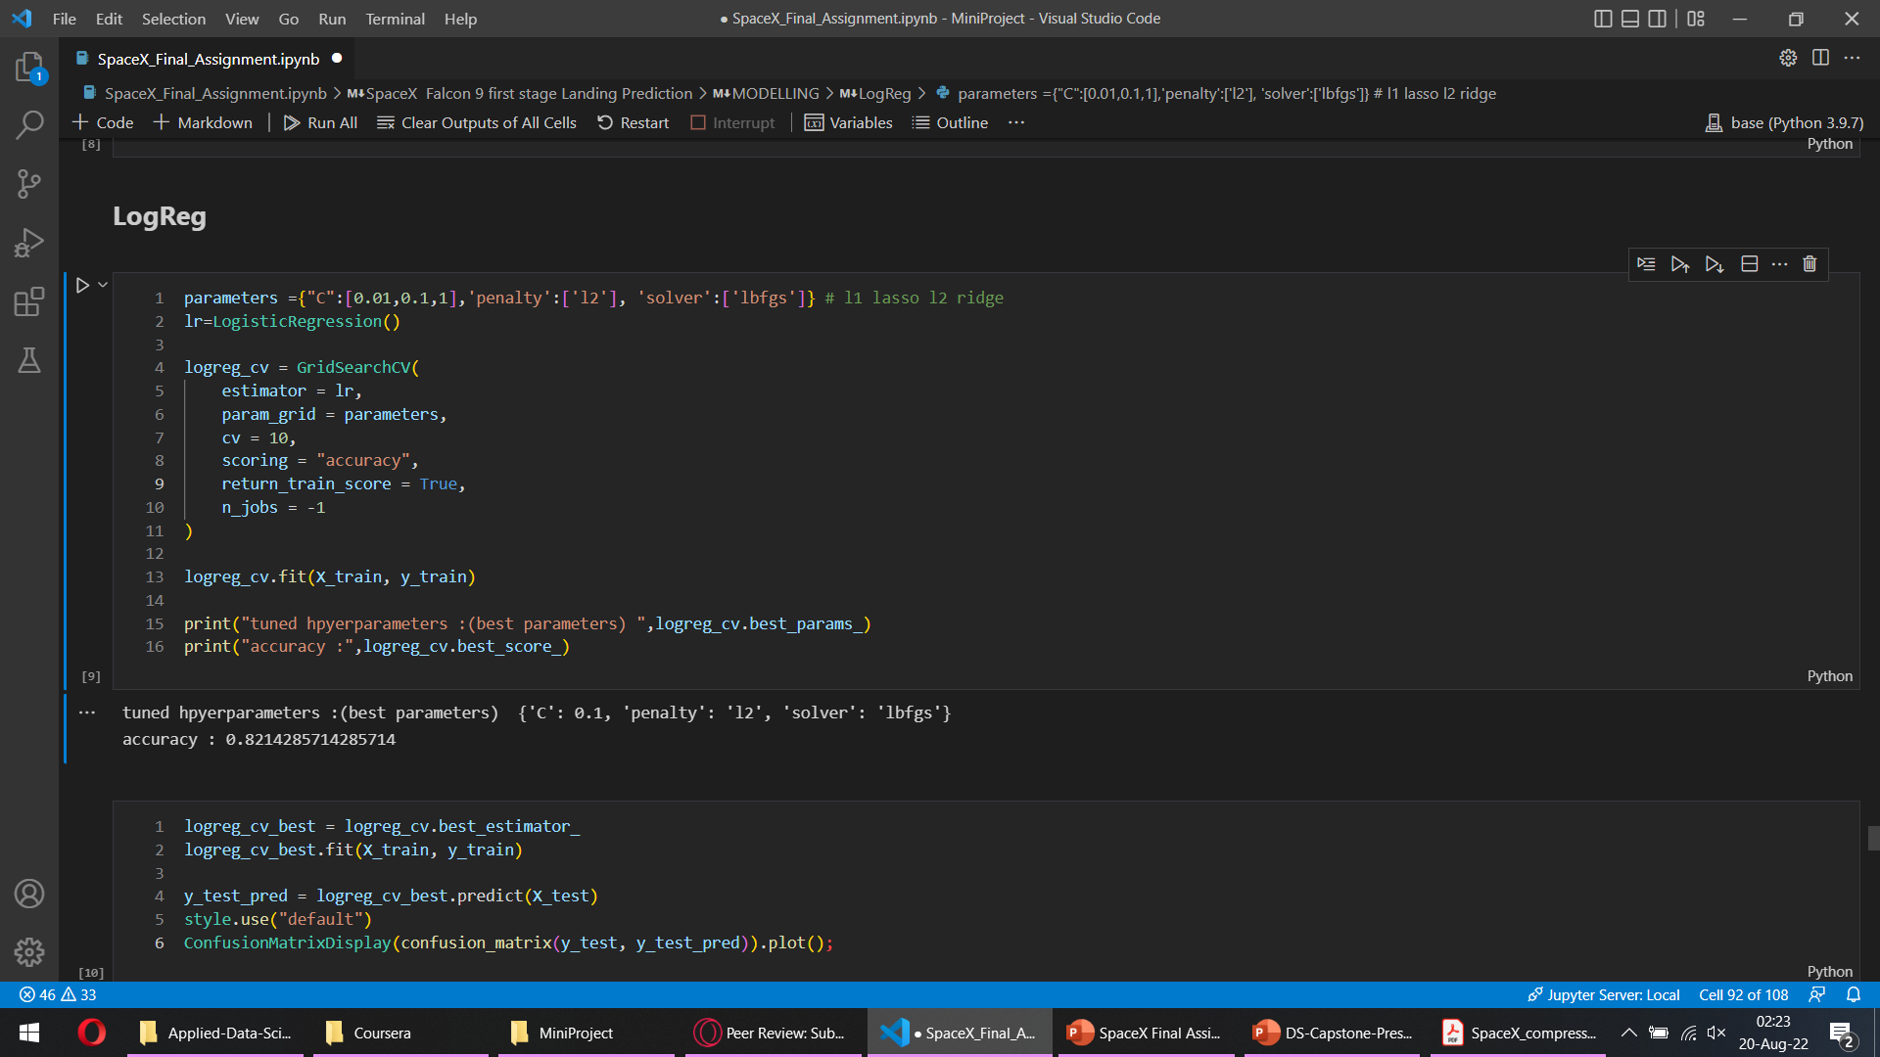
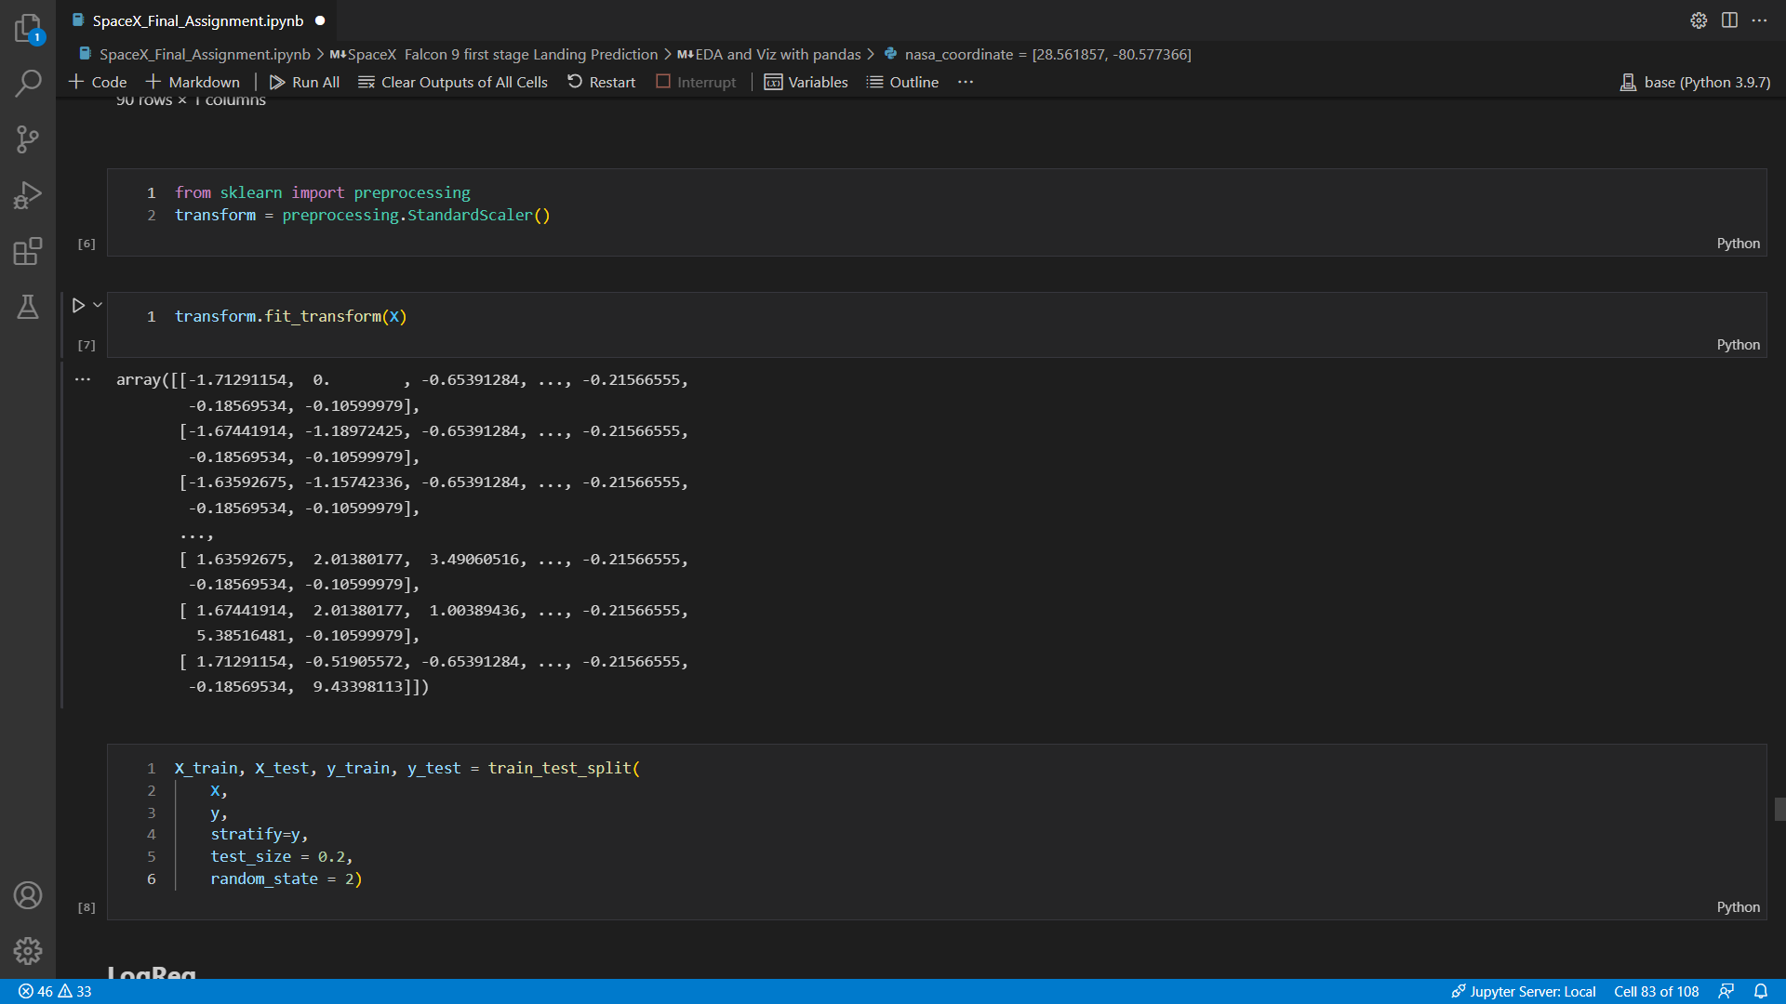
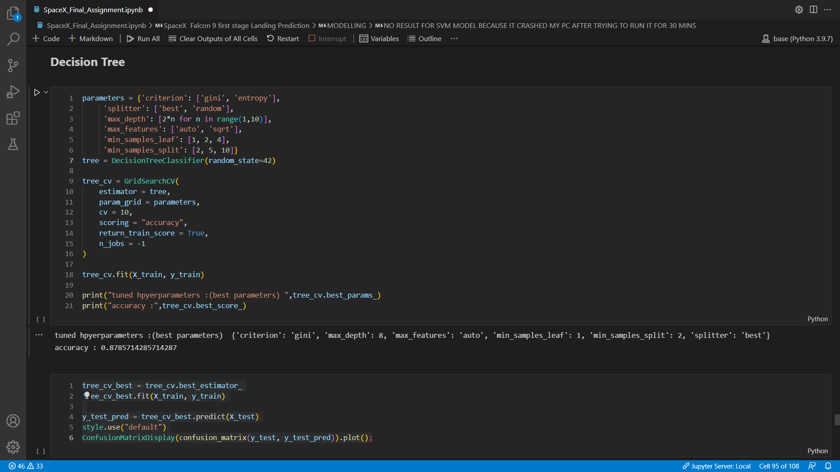
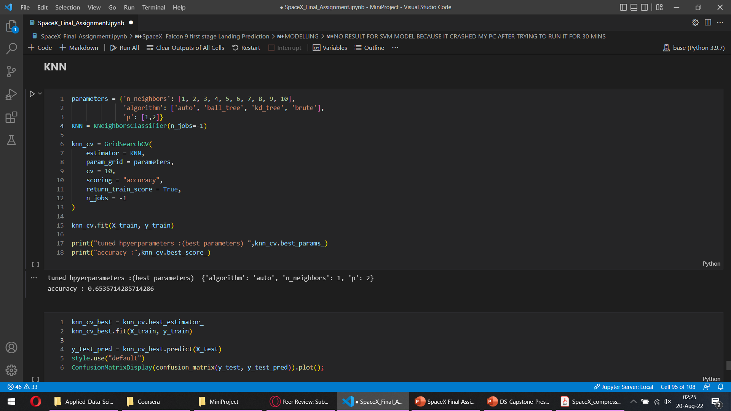
Modelling

Slide 12
Results

Slide 13
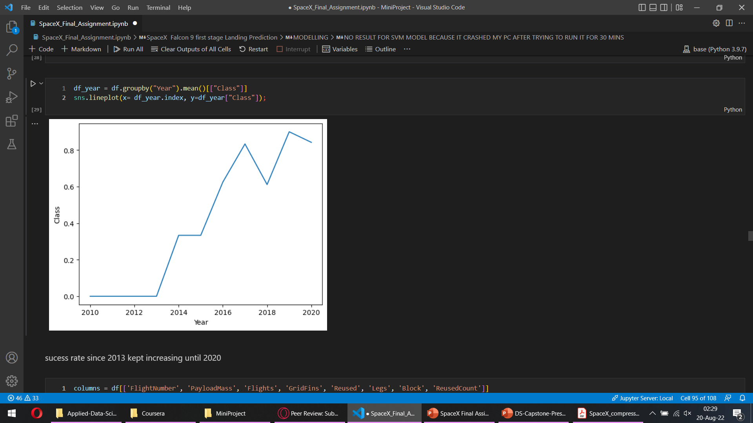
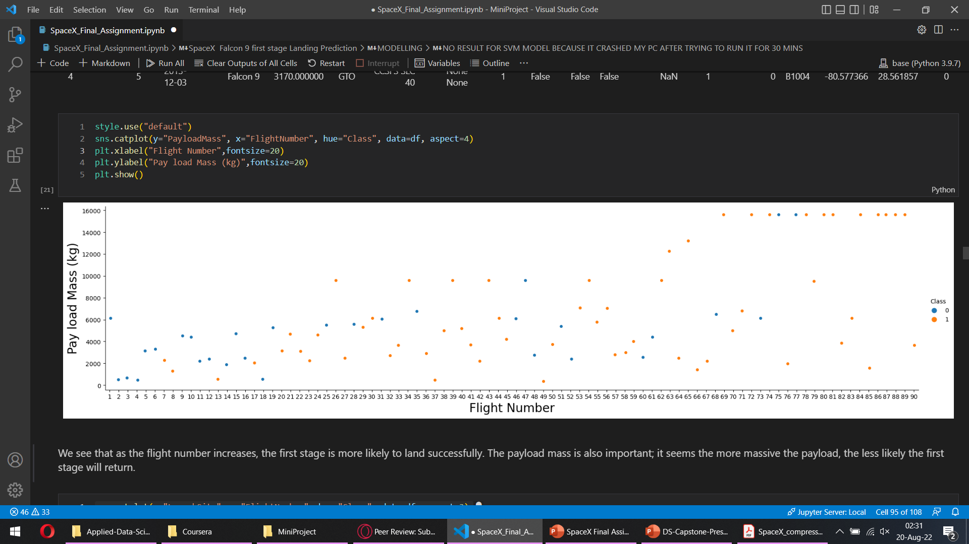
EDA Results
SO orbit has a success rate of 0% because there's only 1 launch attempt and it hasn't succeed. Meanwhile, Launch on orbit ES-L1, GEO, HEO, and SSO have 100% success rate

Slide 14
EDA Results
Name of the launch sites
Total Payload Carried by NASA
Launch site locations

Slide 15
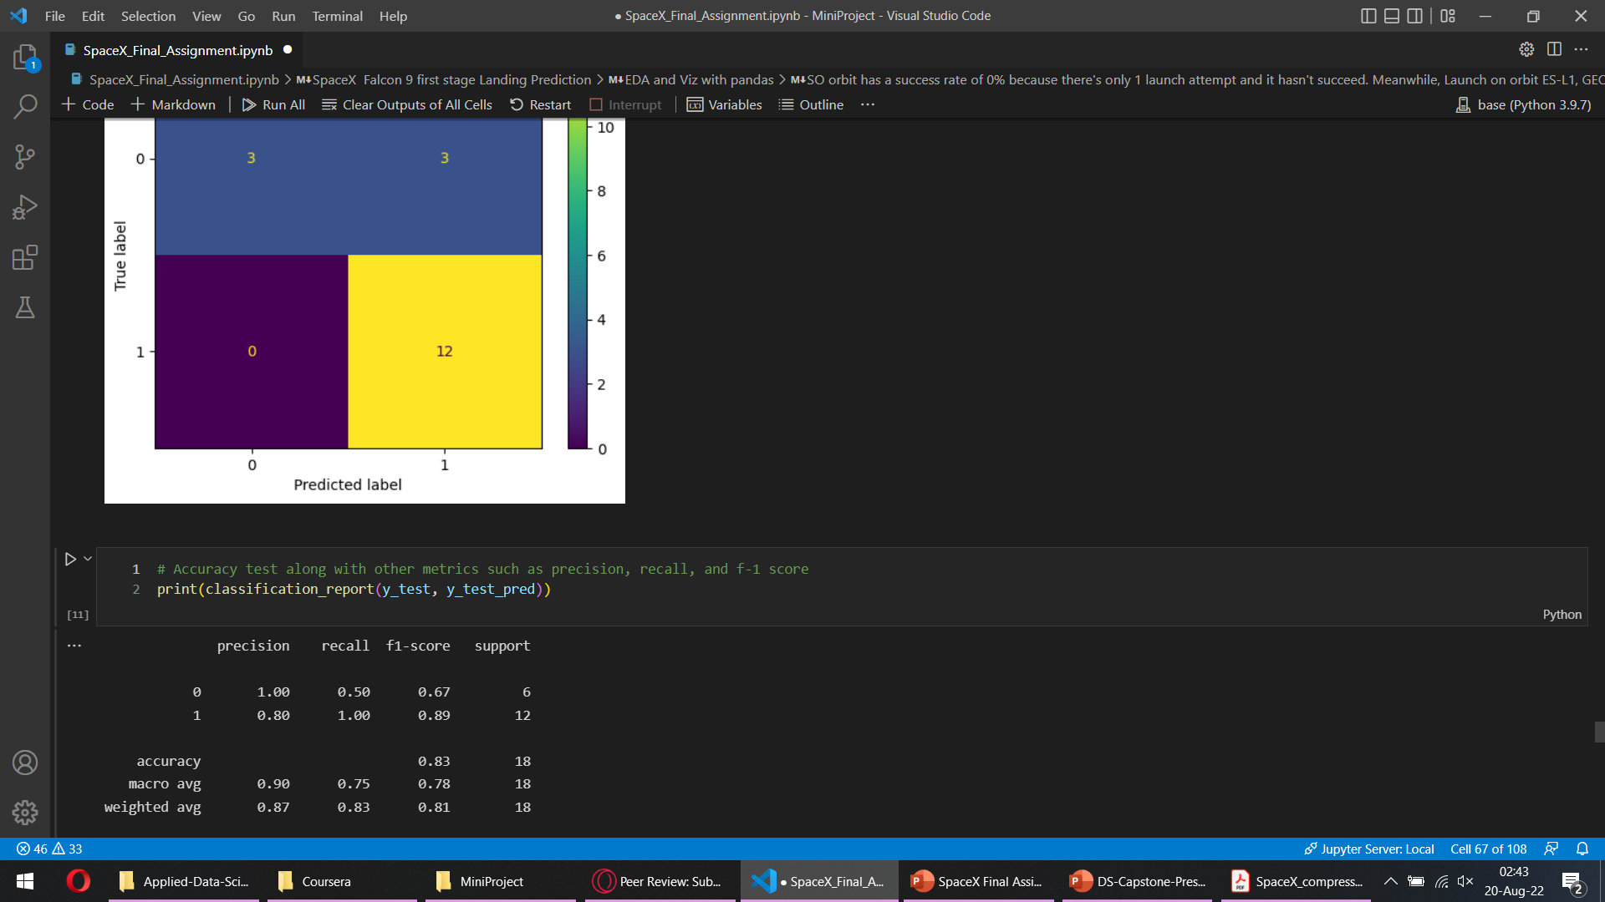
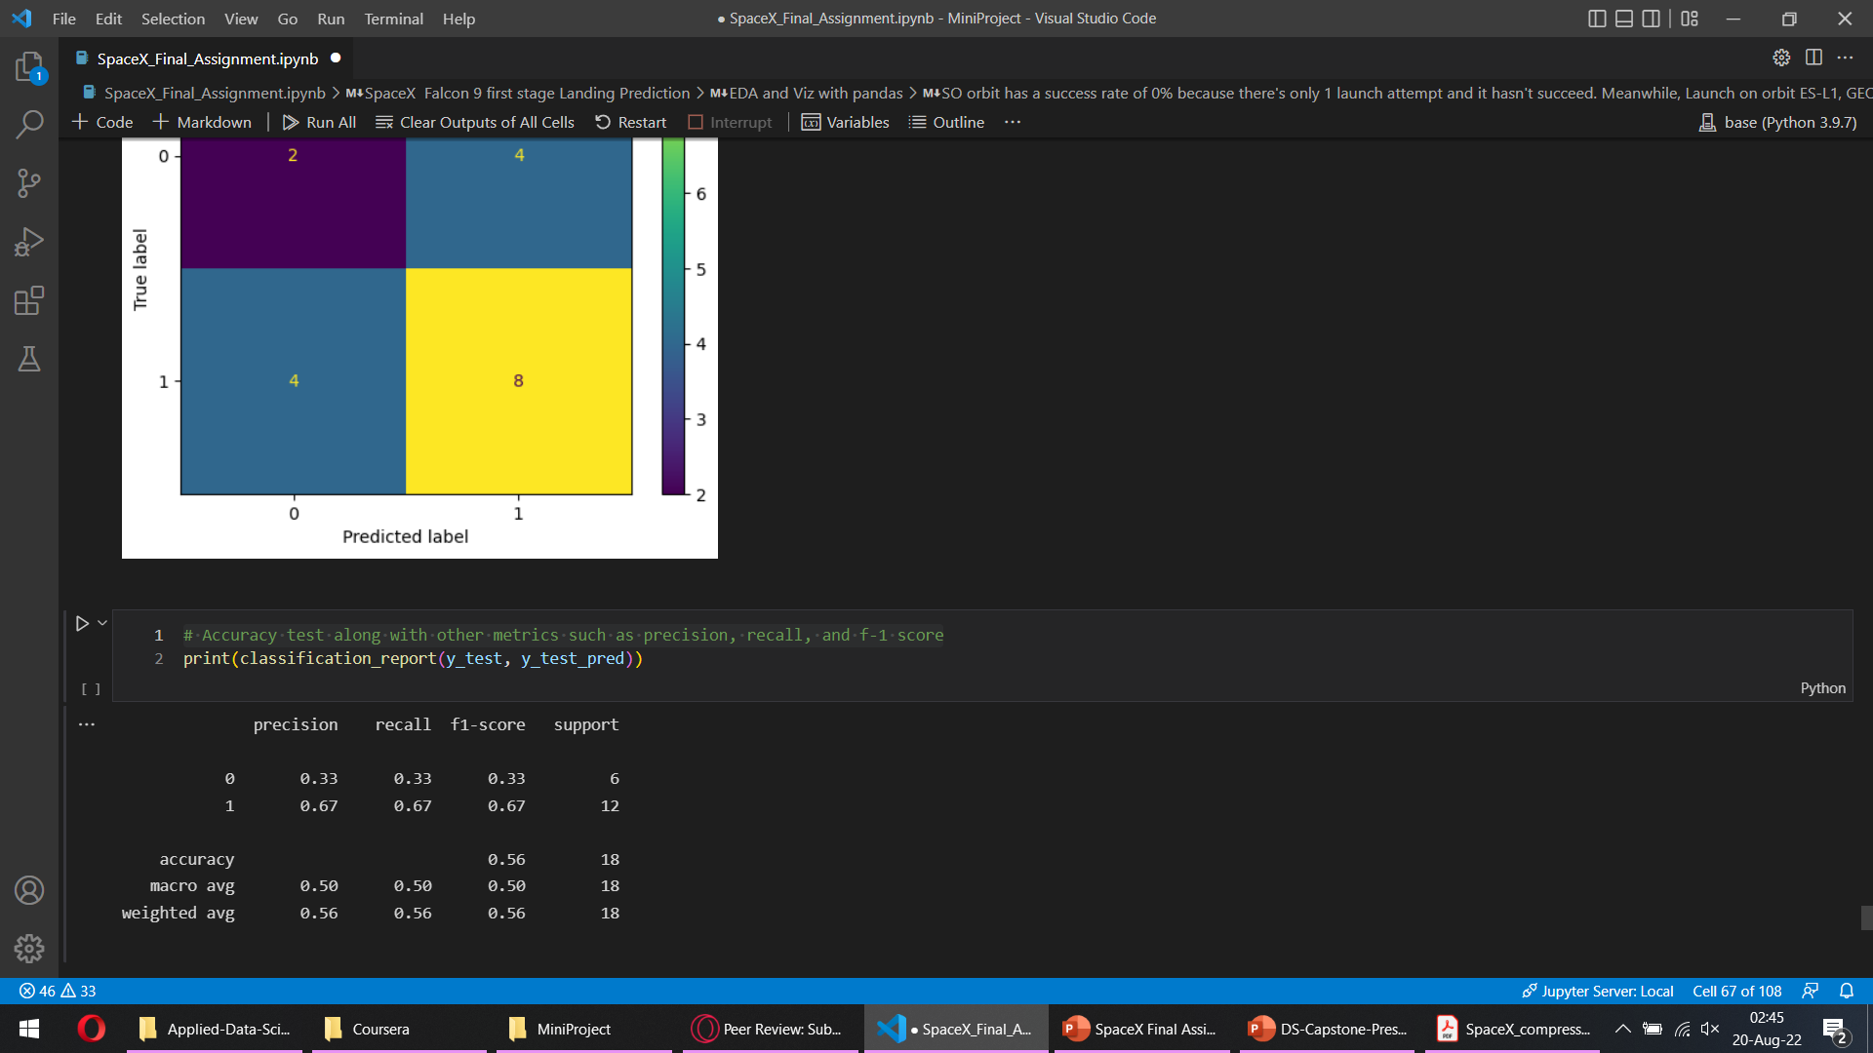
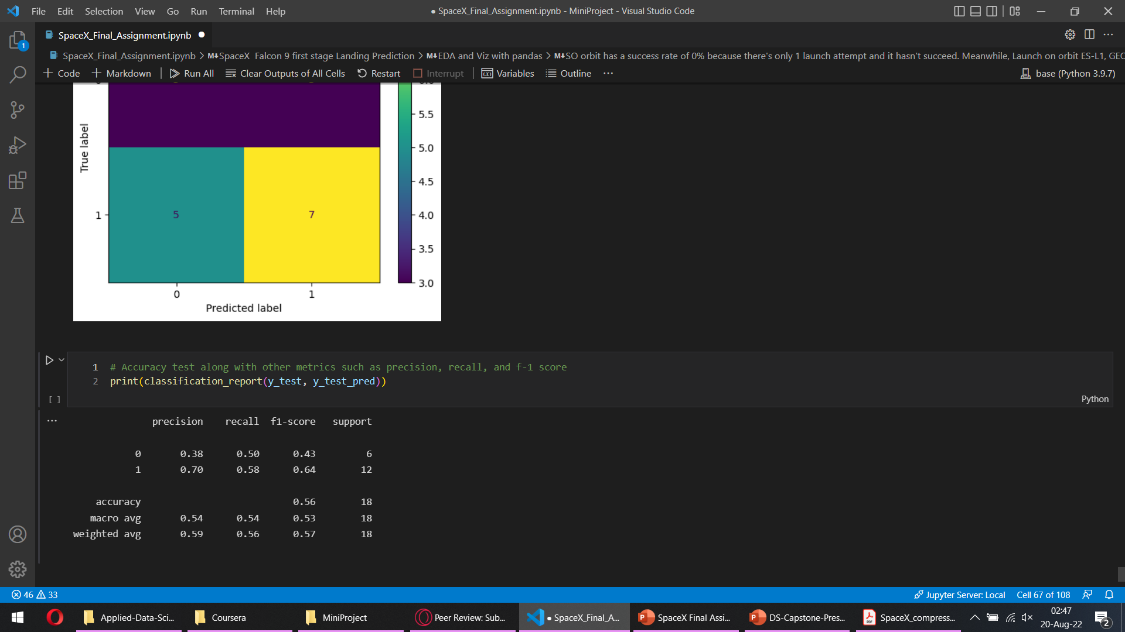
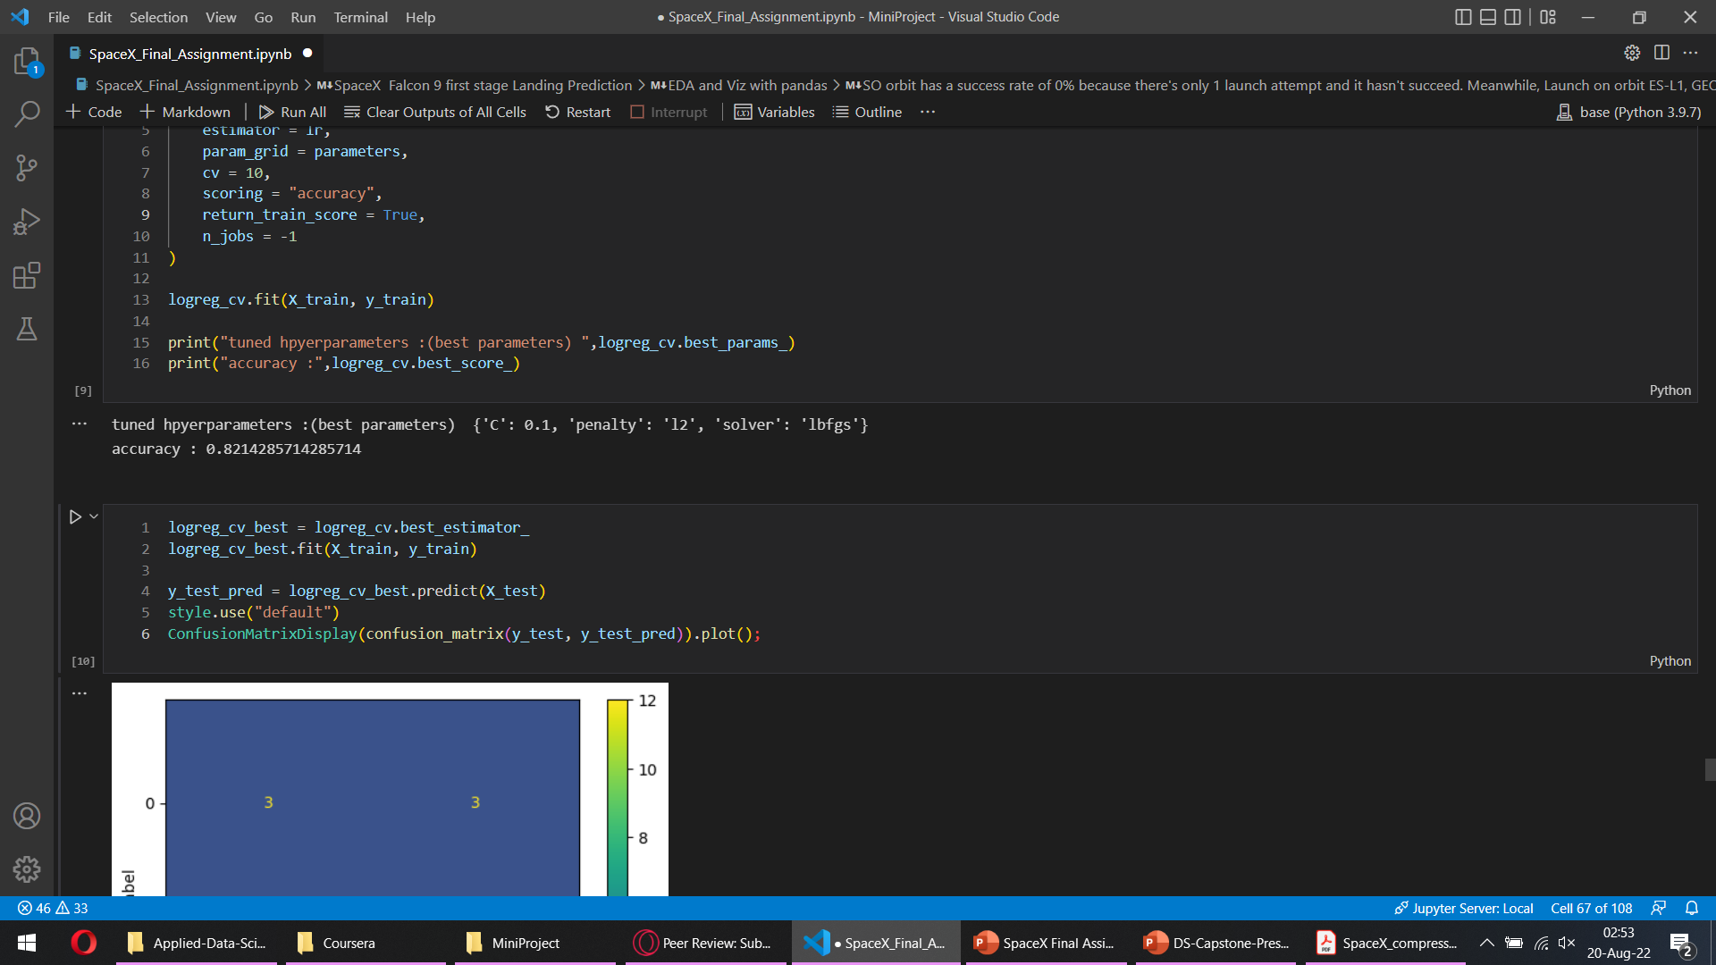
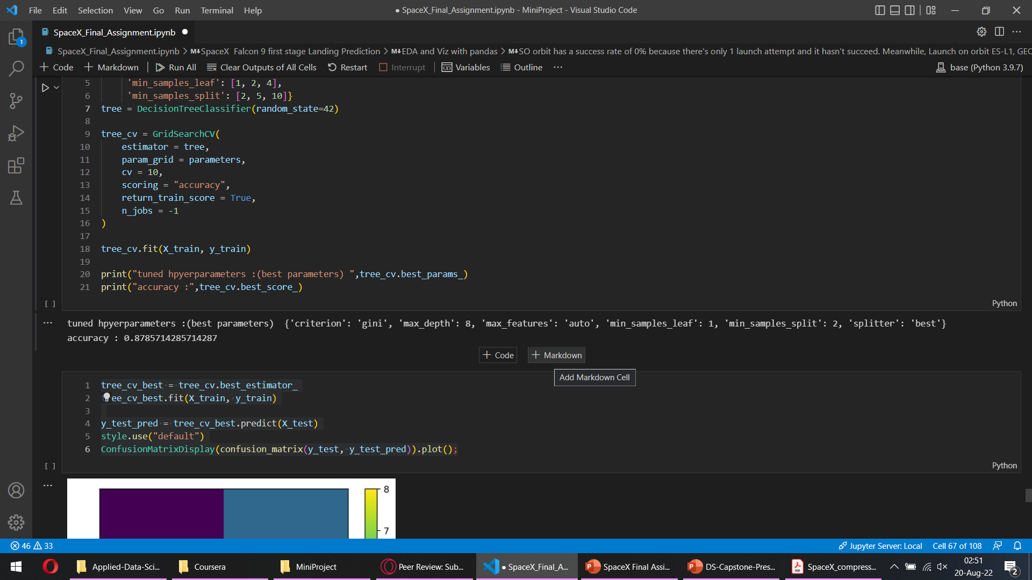
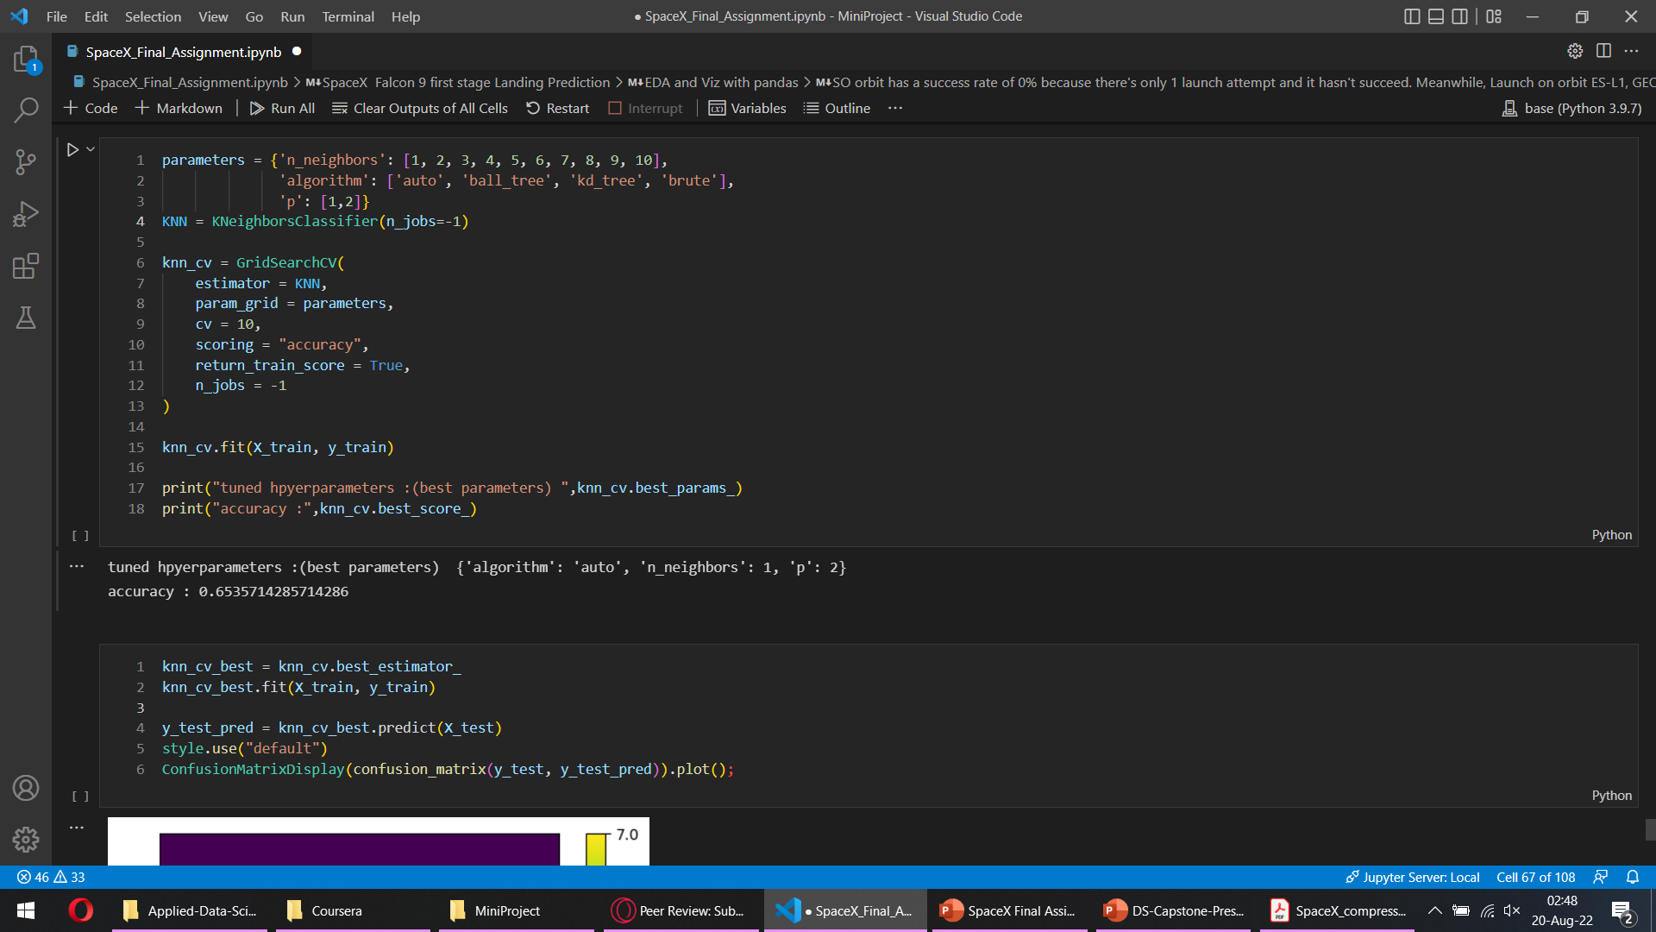
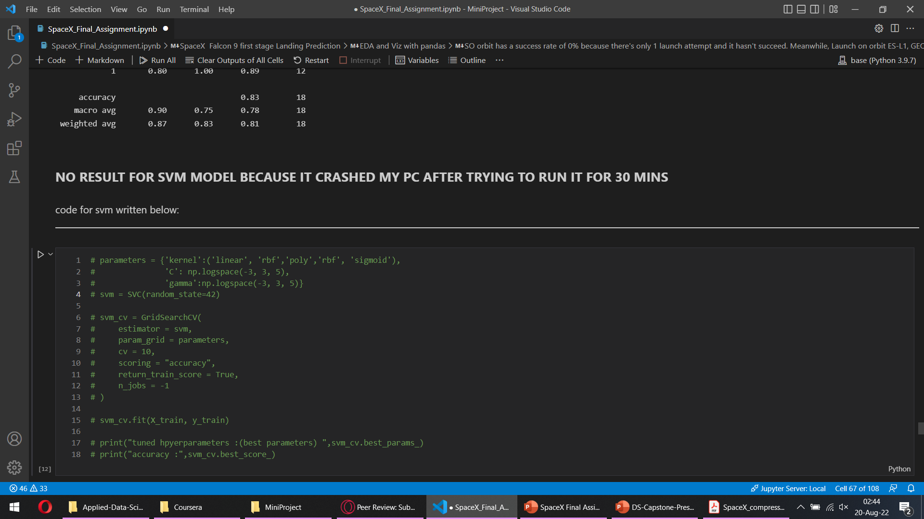
Modelling Results
Logreg Test Accuracy (Best Test Result)
Decision Tree Test Accuracy (Overfitting)
KNN Test Accuracy (Underfitting)
Decision Tree Train Accuracy (best TRAIN result)
KNN Train Accuracy (n_neighbors=1 from gridsearch)
Logreg Train Accuracy (Best fit)

Slide 16
Conclusion
Success rate keeps increasing over time, as more and more launch is being done.
Heavier payloads seems to have a better success on landing, however this might happen because of the fact that most of the heavy payloads are launched only after flight number is relatively high (correlates with our 1st point in this conclusion).
Launch on orbit ES-L1, GEO, HEO, and SSO have 100% success rate.
We find that Logistic Regression model is best fit for this dataset. (83% accuracy)

Slide 17


